Slide 1
Periphery Handling PCB
Rappai Soma
ONQZ95

Slide 2
About
Origination of the idea
My Initial Plans
Budget
Difiiculties
My Goal
Progress

Slide 3
Origination of the Idea
For BKV
GPS
GSM
Microphone
Money

Slide 4
My Initial Plans
One PCB
Six Peripferies
Own GPS
Wireless

Slide 5
Budget
My first estimation
My plan
Actual Cost

Slide 6
Difficulties
Making the Board(Ironing)
No GSM -> No wireless
The Programming
Size
Parts

Slide 7
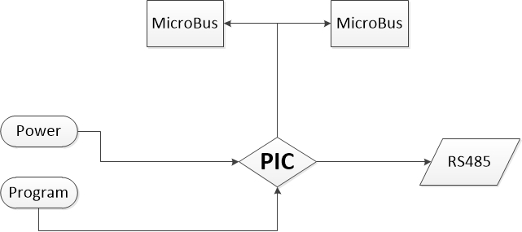
My Goal
Simple use
Precise(50m)
Visualized in Computer

Slide 8
Progress
Board
GPS
Program

Slide 9
Thank You for Your Attention

